Slide 1
Laravel JWT authentication

Slide 2
JWT authentication demo
Install Laravel 9
composer create-project laravel/laravel DumApp-jwt
cd DumApp-jwt
Create a database
Install and set up JWT
Install the newest version of the package using this command:
composer require php-open-source-saver/jwt-auth
Next, we need to make the package configurations public. Copy the JWT configuration file from the vendor to confi/jwt.php with this command:
php artisan vendor:publish --provider="PHPOpenSourceSaver\JWTAuth\Providers\LaravelServiceProvider“
Now, we need to generate a secret key to handle the token encryption. To do so, run this command:
php artisan jwt:secret
This will update our .env file

Slide 3
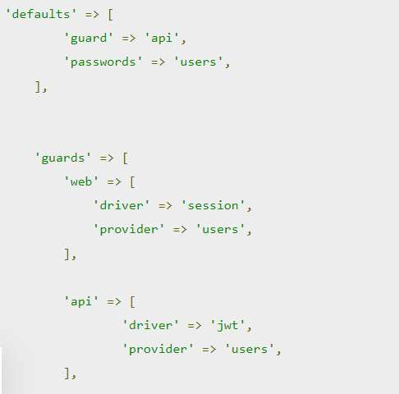
Configure AuthGuard
Inside the config/auth.php file, we’ll need to make a few changes to configure Laravel to use the JWT AuthGuard to power the application authentication.
In this code, we’re telling the API guard to use the
JWT driver and to make the API guard the default.

Slide 4
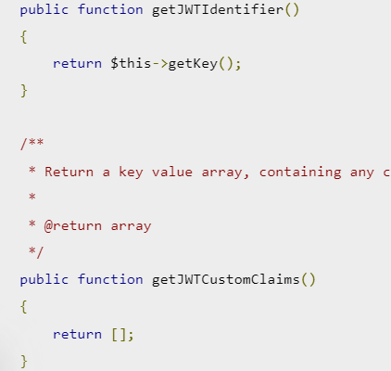
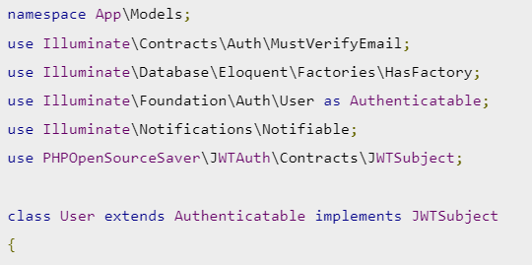
Modify the User model
In order to implement the PHPOpenSourceSaverJWTAuthContractsJWTSubject contract on our User model, we’ll use two methods:
getJWTCustomClaims() and getJWTIdentifier().

Slide 5
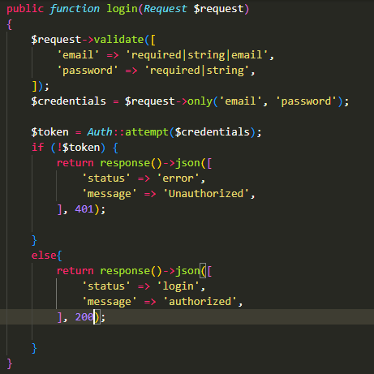
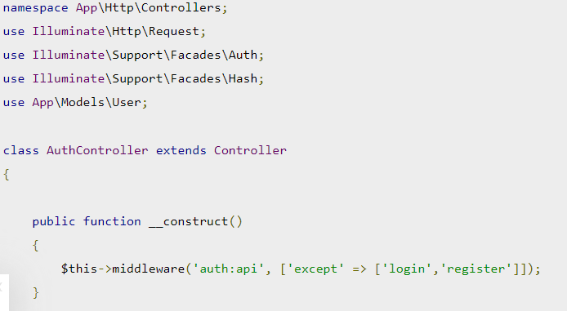
Create the AuthController
php artisan make:controller AuthController

Slide 6
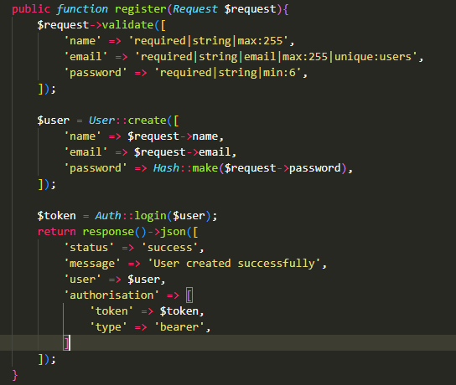
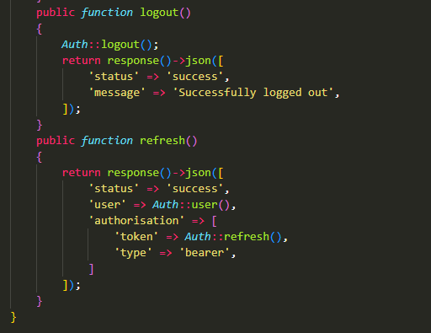

Slide 7
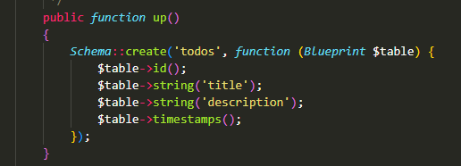
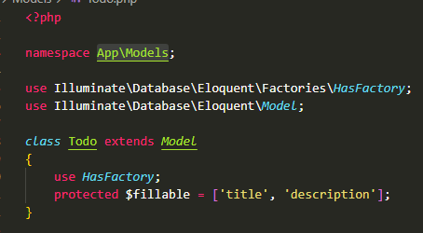
Create the todo model, controller, and migration
We’ll create the Todo model, controller, and migration all at once with the following command:
php artisan make:model Todo –mc

Slide 8
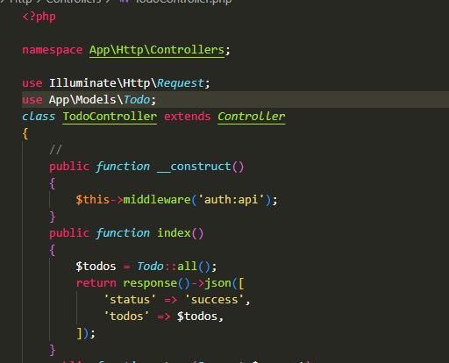
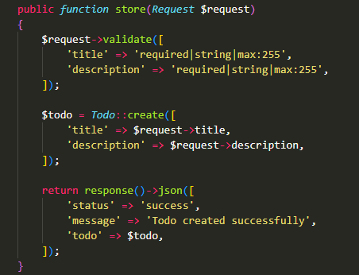
Modify the todo controller
Next, go to the app/Http/Controllers/TodoController.php file, and replace the content with the following code:

Slide 9
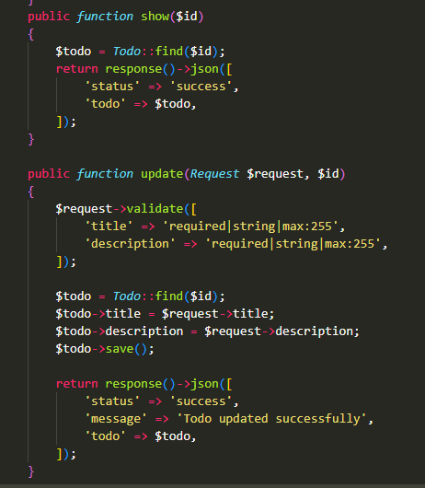
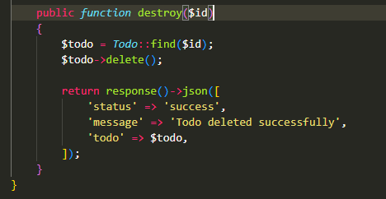
Modify the todo controller

Slide 10
Commands
composer create-project laravel/laravel DumApp01
composer require php-open-source-saver/jwt-auth
php artisan vendor:publish --provider="PHPOpenSourceSaver\JWTAuth\Providers\LaravelServiceProvider“
php artisan jwt:secret

Slide 11
use PHPOpenSourceSaver\JWTAuth\Contracts\JWTSubject;
implements JWTSubject
public function getJWTCustomClaims(){
return $this->getKey();
}
public function getJWTIdentifier(){
return [];
}

Slide 12
php artisan make:controller AuthController
public function __construct()
{
$this->middleware('auth:api', ['except' => ['login','register']]);
}
public function register(Request $request){
$user = User::create([
'name' => $request->name,
'email' => $request->email,
'password' => Hash::make($request->password),
]);
$token = Auth::login($user);
}
public function login(Request $request)
{
$credentials = $request->only('email', 'password');
$token = Auth::attempt($credentials);
$user = Auth::user();
return response()->json([
'status' => 'success',
'user' => $user,
'authorisation' => [
'token' => $token,
'type' => 'bearer',
]
]);
}

Slide 13
Route::controller(AuthController::class)->group(function () {
Route::post('login', 'login');
Route::post('register', 'register');
});

